Slide 1
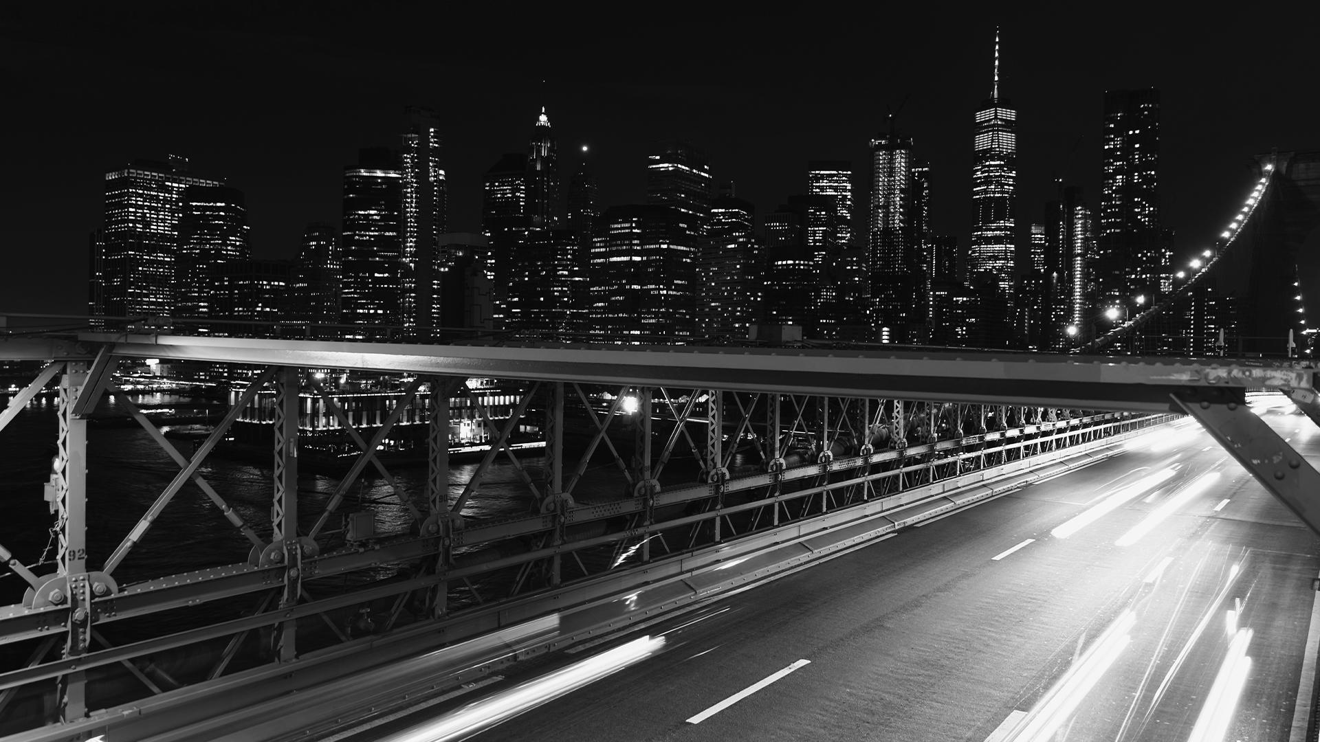

Uber Fare Prediction and Analysis using Machine Learning
TEAM - 8 Bhavya Sree Gudiseva – G41949795 Saiteja Singirikonda – G33754913 Dinesh Reddy Reddem – G30893344

Slide 2
CONTENTS OF THIS PROJECT
Problem Definition and Understanding
Data Preparation and Pre-processing
Model Selection and Development
Generalization
Evaluation and Performance Metrics

Slide 3
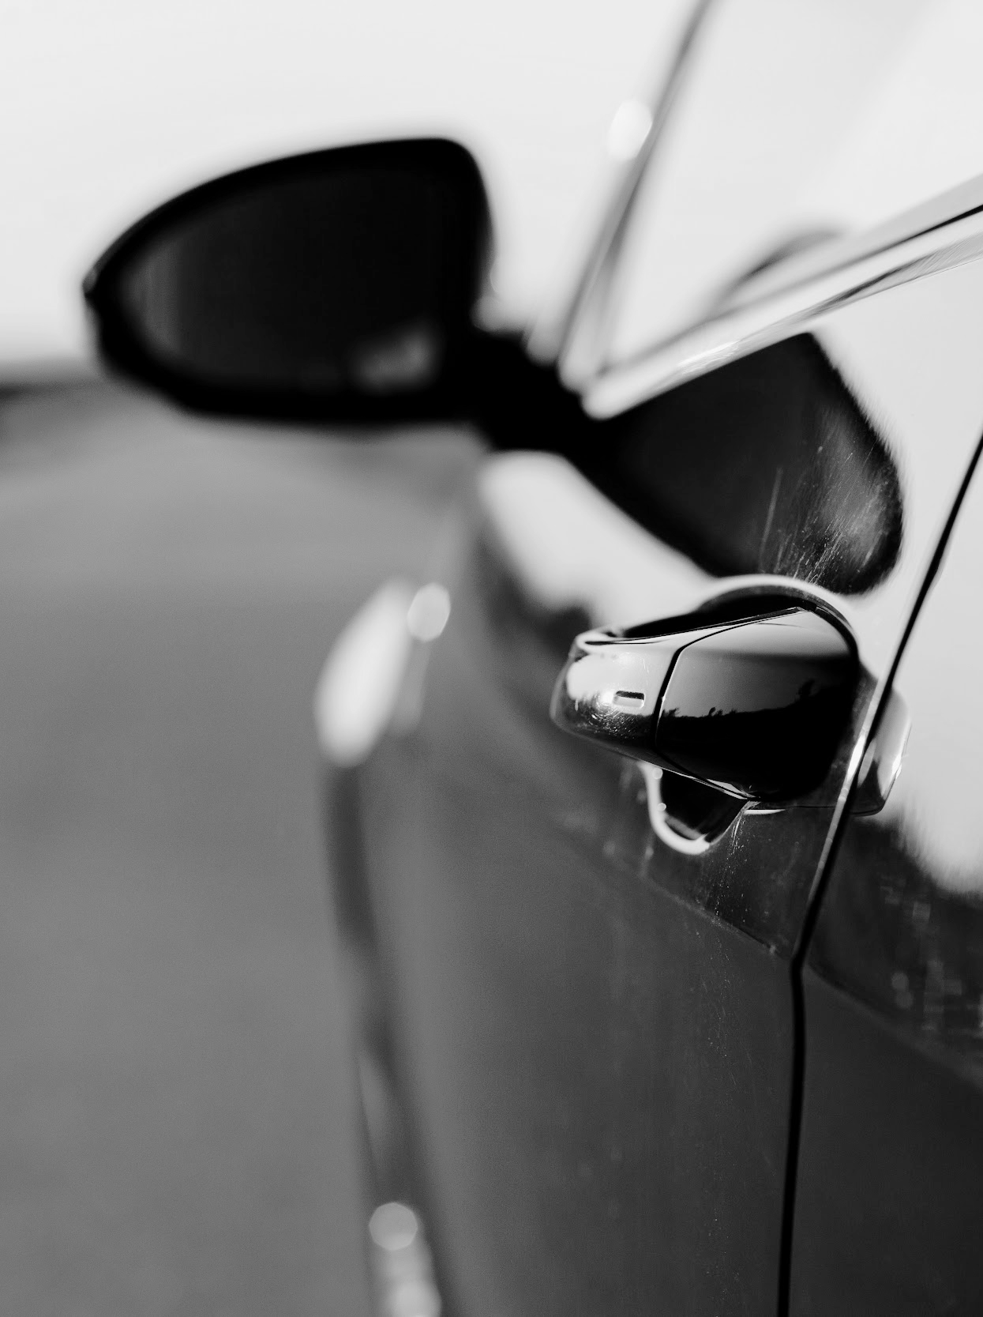
PROBLEM STATEMENT
The goal of this project is to create a predictive model that forecasts Uber's fare prices and ride demand by leveraging data on distance, surge pricing, locations, weather conditions, traffic, and journey times. The model's effectiveness will be judged on its accuracy in predicting fares and anticipating demand spikes, which is vital for enhancing Uber's operational efficiency and customer satisfaction.

Slide 4
DATA PREPARATION AND PRE-PROCESSING
FEATURE SELECTION
CATEGORICAL ENCODING
DATA CLEANING
FEATURE ENGINEERING
Performed one-hot encoding on categorical columns of a dataFrame
LassoCV selects key features for 'price' prediction.
OUTLIERS HANDLING
Correlation analysis identifies temperature, climate and time features influencing Uber prices.
Removed rows with missing 'price' data.
Outlier removal in 'price’ column using IQR.

Slide 5
MODEL SELECTION AND DEVELOPMENT
Linear Regression
Decision Tree
Random Forest
Gradient Boost
Neural Networks

Slide 6
GENERALIZATION
Evaluation Metric | Linear Regression | Decision Tree | Random Forest | Gradient Boost | Neural Networks
MSE | 5.11632 | 2.70279 | 0.00180 | 0.55223 | 5.52703
RMSE | 2.26192 | 1.64401 | 0.04244 | 0.74312 | 1.93062
MAE | 1.67428 | 1.10109 | 0.00259 | 0.52166 | 2.35096
R^2 Score | 0.93345 | 0.96484 | 0.99997 | 0.99281 | 0.92810

Slide 7
EVALUATION AND PERFORMANCE METRICS
MSE 1.6263 RMSE 4.0328 MAE 3.1361 R^2 Score 1.0
MSE 0.0033 RMSE 0.0581 MAE 0.0022 R^2Score 0.999
MSE 0.0018 RMSE 0.0424 MAE 0.0025 R^2Score 0.999
MSE 0.5522 RMSE 0.7431 MAE 0.5216 R^2Score 0.9928
LINEAR REGRESSION
DECISION TREE
RANDOM FOREST
GRADIENT BOOST

Slide 8
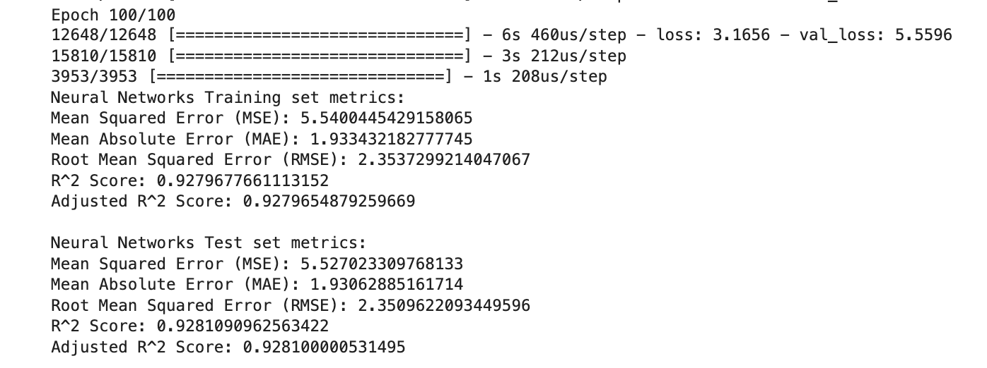
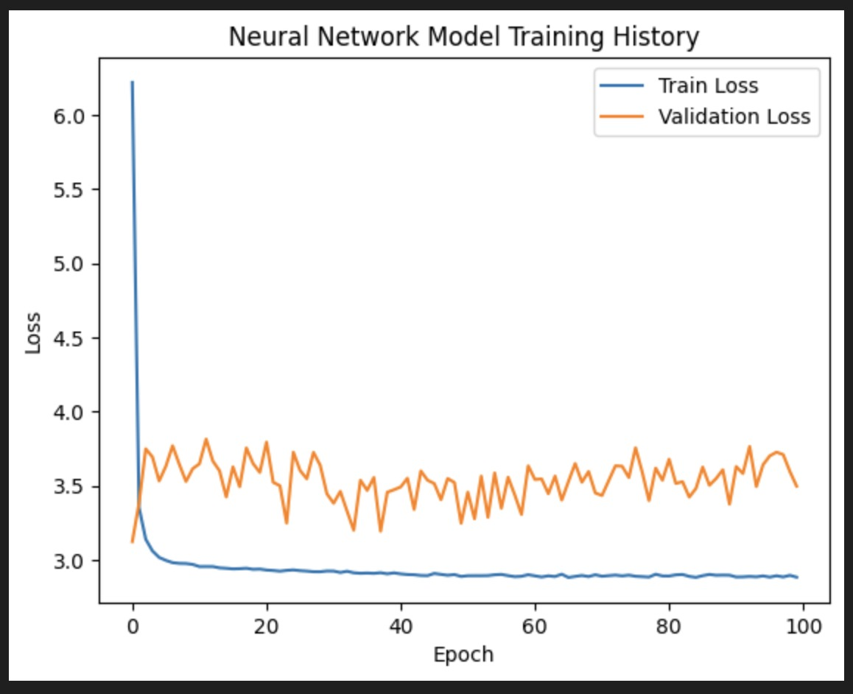
NEURAL NETWORK

Slide 9

CONCLUSION
After meticulous data preprocessing and exploratory analysis on the Uber Boston dataset, we are now better equipped with cleaned data and insights. This enhanced dataset is ready for further analysis, modeling, or any other advanced data tasks. The visualizations and correlation metrics provided a foundation for understanding the underlying patterns in the data. Through these endeavors, we aim to enable Uber to derive actionable insights, optimize its operations in Boston, and ultimately enhance its service for the riders and drivers.

Slide 10

THANK YOU

